Slide 1
Chapter 1
Orientation to SPSS Windows

Slide 2
Learning Objectives
Describe the basic features of Statistical Package for Social Science (SPSS) Windows
Explain the use of variable and data views in SPSS Windows
Explain the primary scales of measurement
Demonstrate the steps used in SPSS for assigning value labels and data entry

Slide 3
Explain the use of the SPSS output viewer and print results
Describe how to save SPSS outputs
Demonstrate the steps to open SPSS sample files
Describe the menu options and associated toolbar of the SPSS Data Editor

Slide 4
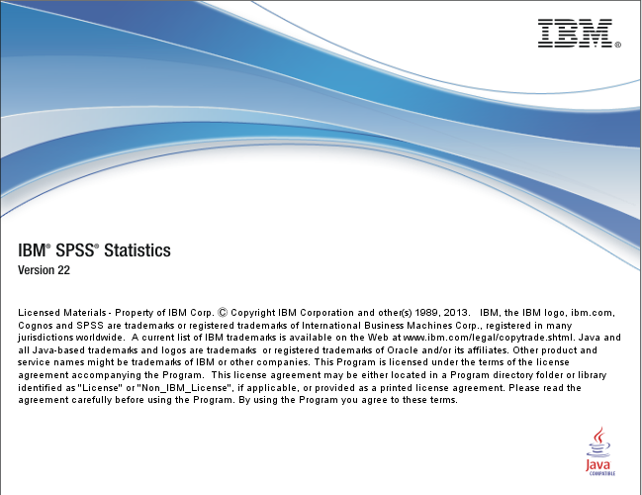
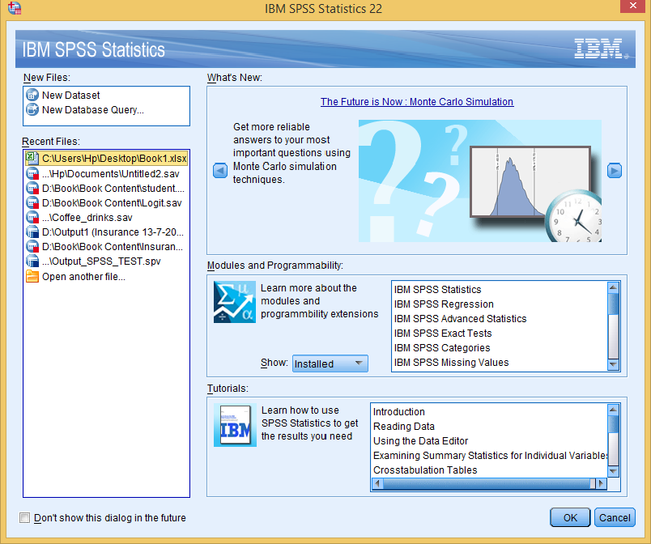
Orientation of SPSS Windows
IBM SPSS Start-up Window
The window comprises various options such as showing the recent files, opening new data set, facility to learn more about modules for statistics, advance statistics, regression, tests and missing values.
Figure 1.1a. SPSS Start-up Window
Figure 1.1b. SPSS Start-up Window: Module

Slide 5
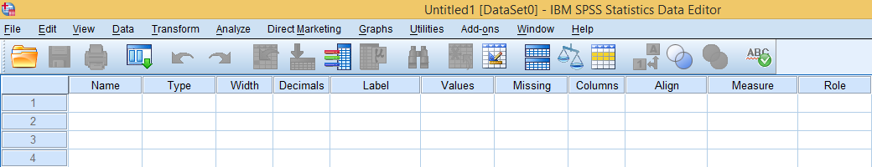
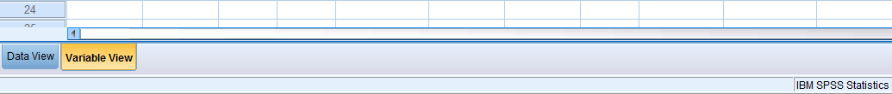
IBM SPSS Statistics Data Editor
Variable View: This view is used to enter all the variables in the program and subsequently used in the analysis.

Slide 6
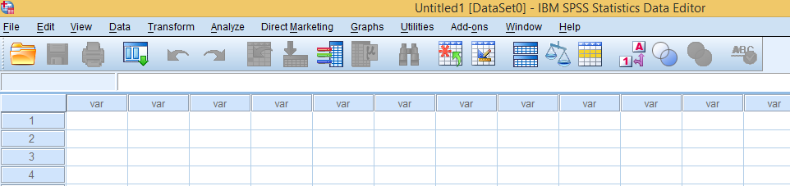
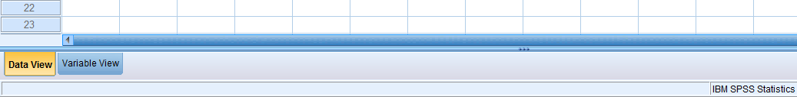
Data View: This window is used to type (enter) numeric for each variable as assigned in the variable view corresponding to each subject or case.

Slide 7
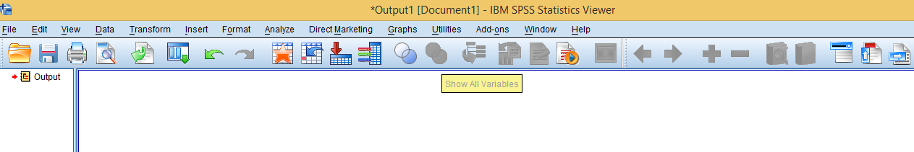
IBM SPSS Statistics Viewer
This viewer displays the results in the form of charts and graphs, frequency tables and test statistic tables corresponding to a particular analysis as executed from the window Statistics Data Editor.

Slide 8
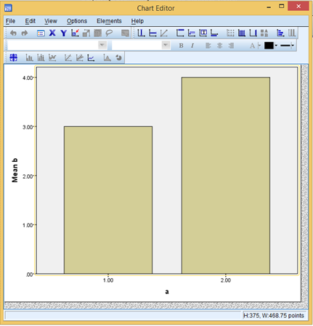
Chart Editor Window
This window is activated by double-clicking on the chart that appears in the output window.

Slide 9
Syntax Editor Window Interaction with SPSS could be performed either by using drop-down menus through the Data Editor window or programming language through the Syntax window.
Exhibit 1.1. SPSS Window » File » New » Click Syntax

Slide 10
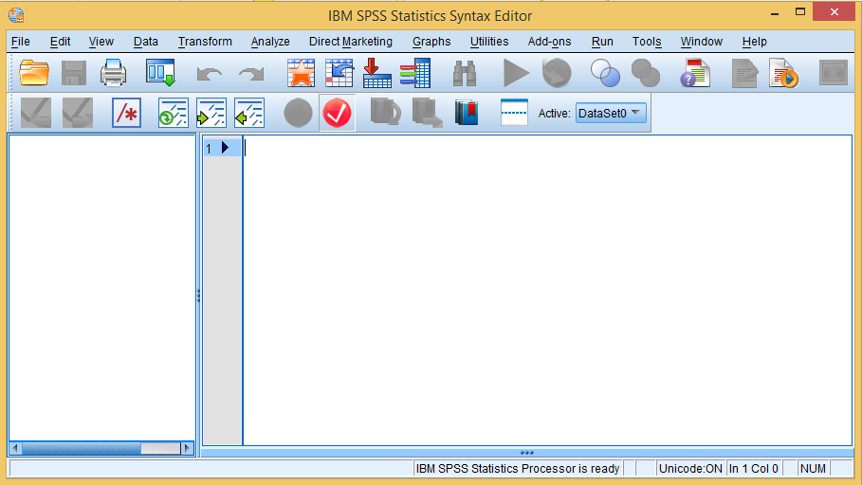
The programmer is required to write Syntax commands rather than using graphical interface to perform in the Syntax window.

Slide 11
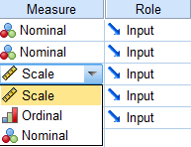
Scales of Measurement
The measure function in SPSS indicates the scale of a particular variable as assigned in the variable view in the SPSS Data Editor.
Nominal: It is used to classify the cases or subjects into distinct and mutually exclusive categories.
Ordinal: It is used to assign the rank order for various attributes, objects or subjects.
Interval: It is used to measure the behavioural responses such as satisfaction, degree of anger and importance among the respondents in social science studies.
Ratio: It is mostly used to measure the exact amount of a variable.

Slide 12
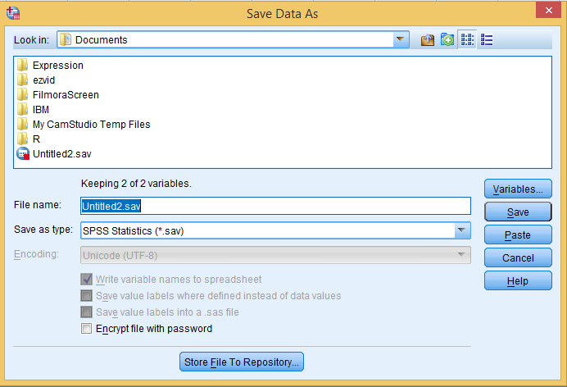
Saving Data Editor and Output Viewer
Exhibit 1.2. Main menu » Click File » Click Save as » Save the file in the folder titled Document with the desired name or select another location in the PC » Click Save

Slide 13
Working on SPSS Sample Files
These files are generated by the IBM SPSS® server at the time of installation of the SPSS package in the PC.
Exhibit 1.3. My PC » Click C-Drive » Click Program Files » Click IBM » Click SPSS » Click Statistics » Click 22 (version of SPSS) » Click Samples » Click English » Sample files are available

Slide 14
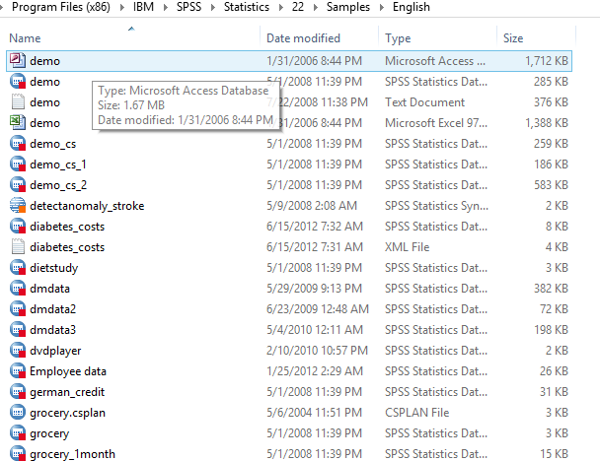

Slide 15
Menu Options in the Data Editor
Menu options available in the Data Editor are used to perform distinct functions in SPSS Windows as shown in the following figure.
Menu: Options
File | Direct marketing
Edit | Graphs
View | Utilities
Data | Add-ons
Transform | Help
Analyze

Slide 16
Data Editor Toolbar
The Data Editor toolbar is shown below.
Data Editor Toolbar
Open | Run Descriptive Statistics
Save | Find
Print | Insert Case
Dialog Recall | Insert Variable
Undo/Redo | Split
Find Case | Weight Cases
Find Variable | Select Cases
Find Case | Value Labels
Find Variable | Use Variable Set
Variable Info | Spell Check

Slide 17
Key Terms
Chart editor window Data view Interval scale Labels Menu options Missing value Nominal scale Ordinal scale | Ratio scale Sample files Statistics data editor Statistics viewer Syntax Window Toolbar Variable view

